Slide 1
Human Motion Analysis Based on Temporal Variations of Shape Subspaces
M2 須藤孝太

Slide 2
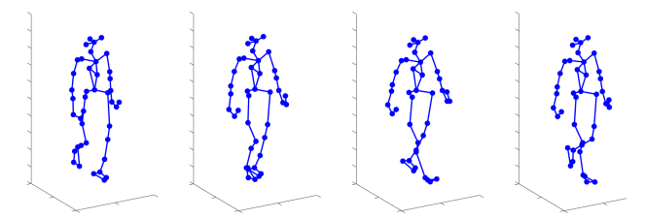
研究背景
Motion Analysis Using Motion Capture Data
Motion analysis using motion capture data — a set of key points obtained from sensors attached to the body
independent of body shape and background information
applicable to healthcare, sports, and activity recognition

Slide 3
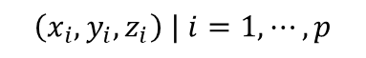
研究背景
Shape Subspace
A three-dimensional subspace of a p-dimensional vector space representing the shapes of a set of p landmarks
Invariant under linear affine transformations
Viewpoint-independent
$$\left(x_{i},y_{i},z_{i}\right) | i=1,⋯,p$$
$$𝒮:three dimensional shape subspace$$

Slide 4
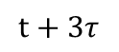
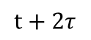
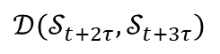
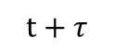
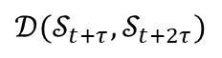
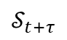
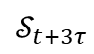
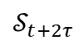
研究背景
Motion Analysis Using Shape Subspaces
Human motion cannot be captured by linear transformations; the shape subspace changes according to the motion
Each frame’s set of key points is represented as a single shape subspace, and the differences between shape subspaces are computed
Geometrically computing motion variations
$𝒮_{t} :$フレーム$t$における3次元形状部分空間
$𝒟\left(𝒮_{t+τ},𝒮_{t+2τ}\right) : 𝒮_{t+τ}$と$𝒮_{t+2τ}$間の3次元差分部分空間
time
$$t+τ$$
$$t+2τ$$
$$t+3τ$$
…
…
…
$$𝒮_{t+2τ}$$
$$𝒟(𝒮_{t+τ},𝒮_{t+2τ})$$
$$𝒟(𝒮_{t+2τ},𝒮_{t+3τ})$$
$$𝒮_{t+τ}$$
$$𝒮_{t+3τ}$$

Slide 5
研究背景
Objective
Motion analysis that geometrically captures essential shape changes, in contrast to directly computing coordinate differences
In particular, evaluating the periodicity and symmetry of gait is effective for diagnosing gait abnormalities
Primarily, motion analysis focusing on the periodicity and symmetry of gait is conducted to contribute to the medical field

Slide 6
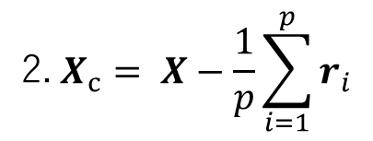
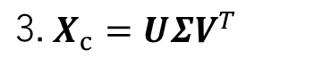
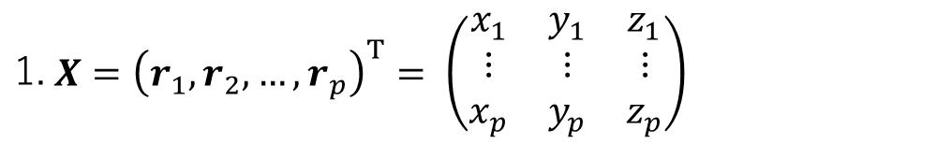
手法・関連研究
Shape Subspace $𝒮$
$$\text{1.} X={\left(r_{1}, r_{2}, …,r_{p}\right)}^{T}= \left(\begin{matrix}x_{1} & y_{1} & z_{1} \\ ⋮ & ⋮ & ⋮ \\ x_{p} & y_{p} & z_{p}\end{matrix}\right)$$
$$\text{2.} X_{c}= X−\frac{1}{p}\sum_{i=1}^{p}{r_{i}}$$
$$\text{3.} X_{c}=UΣV^{T}$$
The shape subspace 𝒮 is defined as the space spanned by the first three column vectors of 𝑼
Ryoma Yataka and Kazuhiro Fukui. Threedimensional object recognition via subspace representation on a grassmann manifold. In International Conference on Pattern Recognition Applications and Methods, volume 2, pages 208–216. SCITEPRESS, 2017.

Slide 7
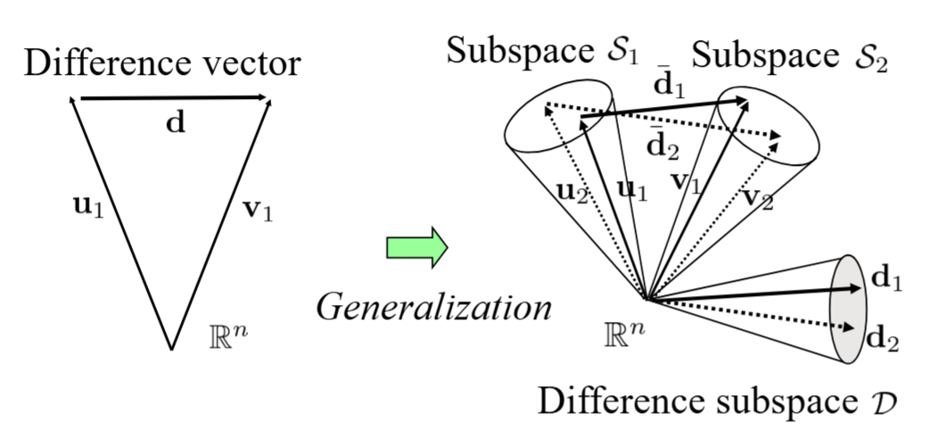
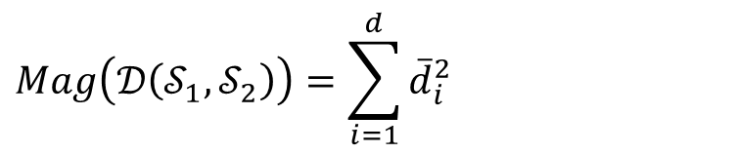
手法・関連研究
difference subspace $𝒟(𝒮_{1},𝒮_{2})$
Represents the difference between subspaces 𝒮₁ and 𝒮₂
The subspace remaining after removing the common subspace from the sum of 𝒮₁ and 𝒮₂.
Magnitude of the difference subspace
$$Mag\left(𝒟\left(𝒮_{1},𝒮_{2}\right)\right)=\sum_{i=1}^{d}{{\overline{d}}_{i}^{2}}$$
Kazuhiro Fukui and Atsuto Maki. Difference subspaceand its generalization for subspace-based methods. IEEEtransactions on pattern analysis and machine intelli-gence, 37(11):2164–2177, 2015.

Slide 8
実験
Targeting the gait motions of healthy individuals and patients (stroke patients), we evaluate symmetry and periodicity

Slide 9
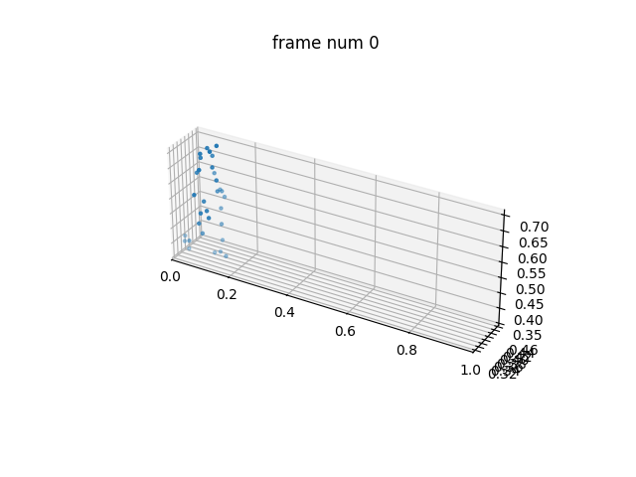
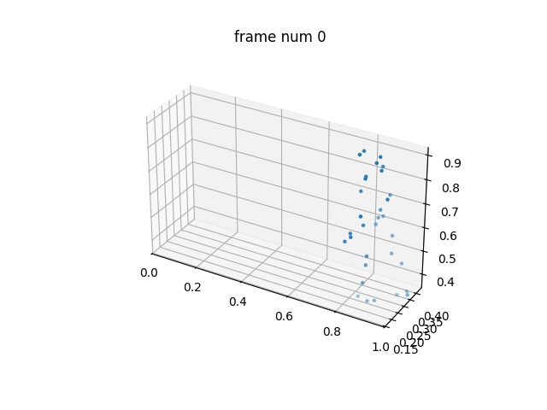
実験
dataset
Full-body gait dataset of 138 healthy adults and 50 stroke survivors
Gait motion capture data from 138 healthy adults (aged 21–86) and 50 stroke survivors were used (multiple gait data per individual).https://pmc.ncbi.nlm.nih.gov/articles/PMC10692332/
healthy
stroke

Slide 10
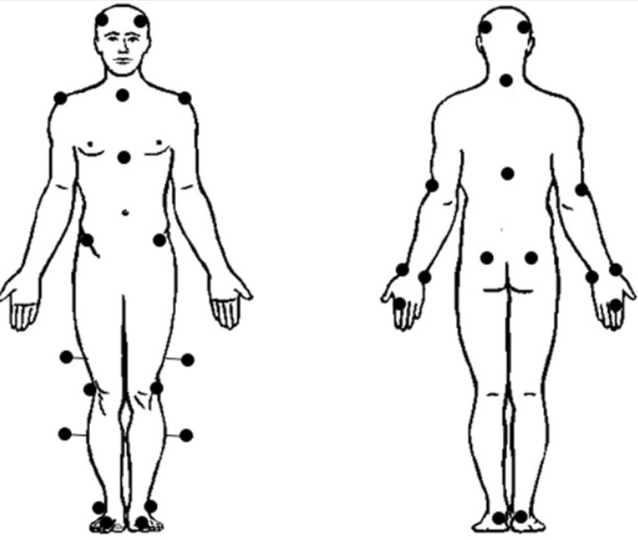
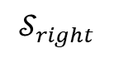
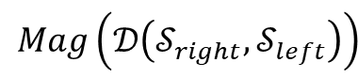
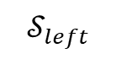
実験
Evaluation of Symmetry
Key points are divided into right and left sides (central points such as the back and chest are included in both)
2. Shape subspaces are created for the right and left sides
3. For each frame, the magnitude of the difference subspace between shape subspaces is computed
$$𝒮_{right}$$
$$𝒮_{left}$$
$$Mag\left(𝒟\left(𝒮_{right},𝒮_{left}\right)\right)$$

Slide 11
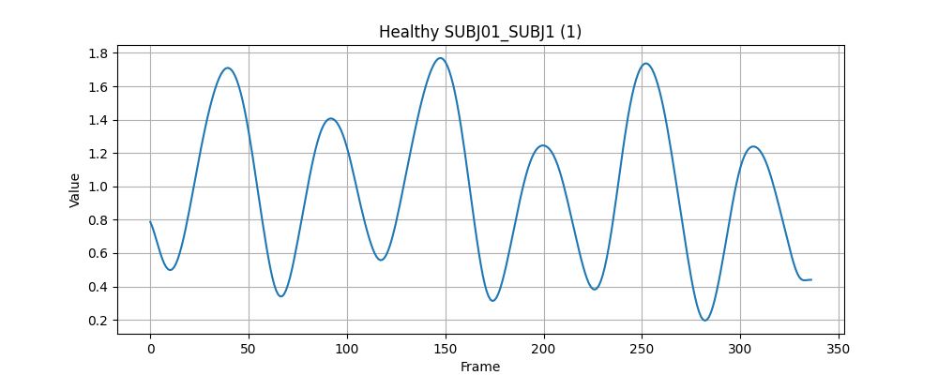
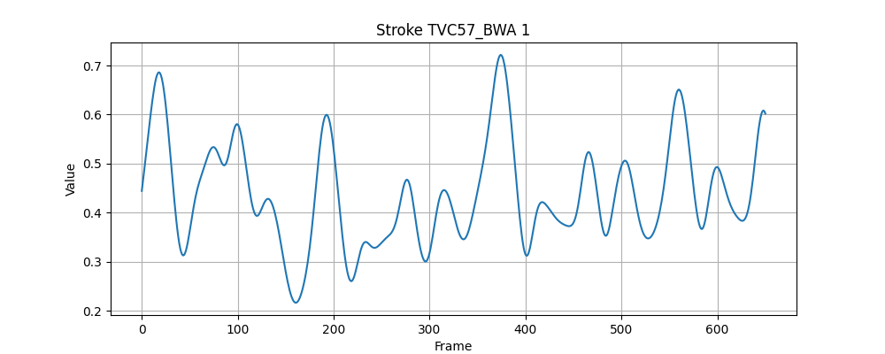
実験
Evaluation of Symmetry (Qualitative Assessment)
healthy
stroke
It was confirmed that healthy individuals exhibit waveforms with nearly perfect periodicity
For patients, those with awkward gait tend to show irregularities in the waveforms, whereas some who can walk relatively normally exhibit clean periodicity similar to healthy individuals

Slide 12
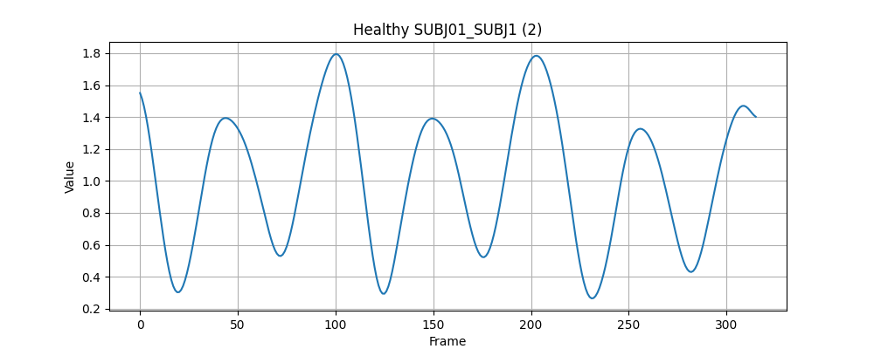
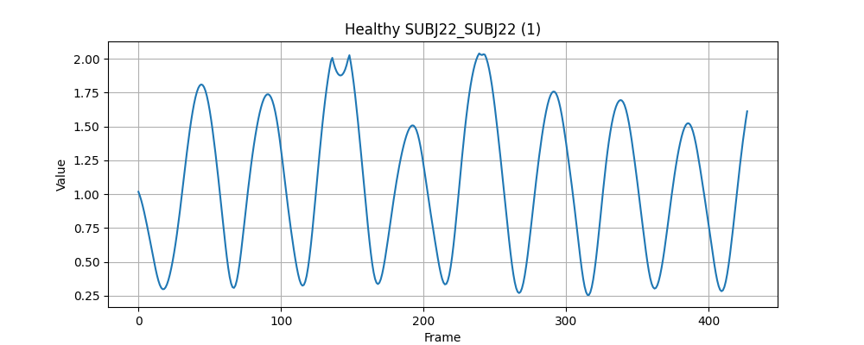
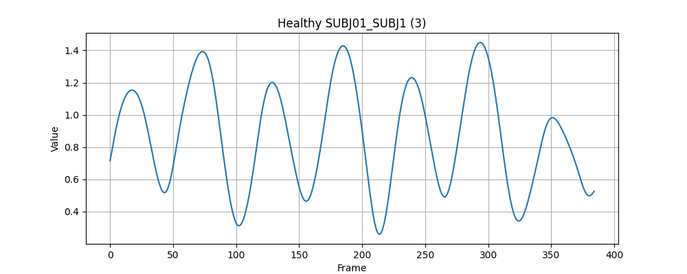
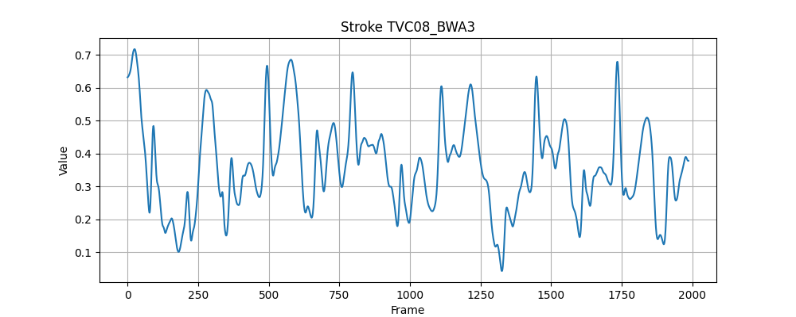
実験
Evaluation of Symmetry (Qualitative Assessment)
Healthy (training)
Healthy (testing)
FFT特徴量
…
Patients
FFT特徴量
The degree of normality is calculated based on the length of FFT feature vectors projected onto the normal subspace. A longer projected vector indicates a higher level of normality
Apply PCA to FFT features to construct the normal subspace

Slide 13
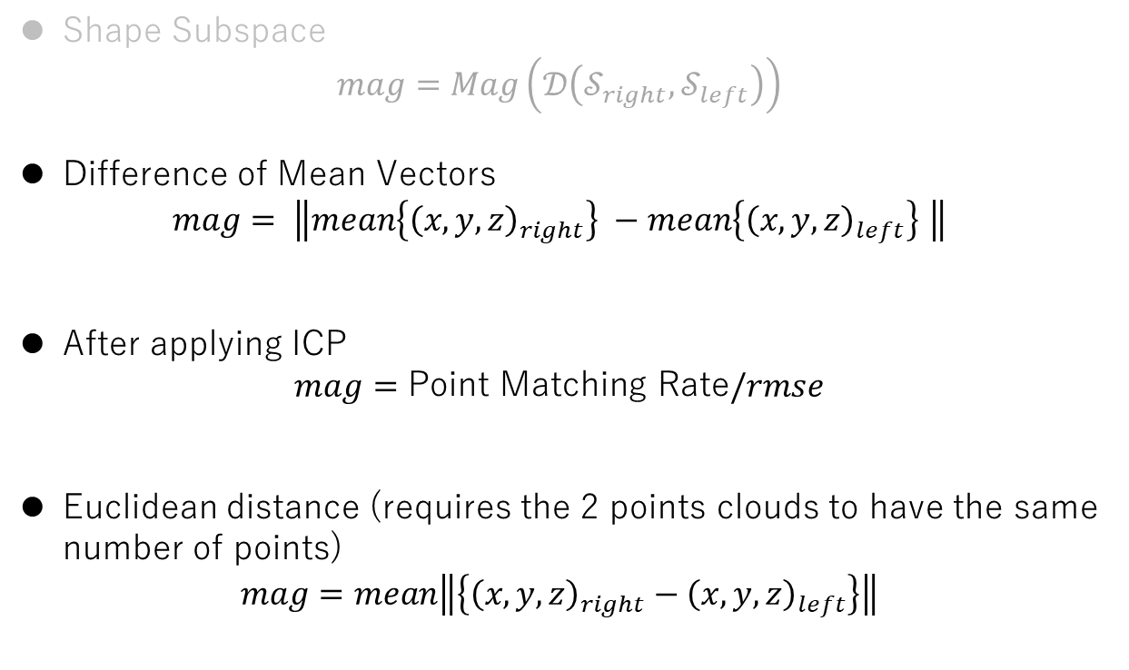
実験
Evaluation of Symmetry
To compare the method and accuracy of shape subspace representation, other methods are also tested
Shape Subspace
$$mag=Mag\left(𝒟\left(𝒮_{right},𝒮_{left}\right)\right)$$
Difference of Mean Vectors
$$mag= \left\|mean\left\{{\left(x,y,z\right)}_{right}\right\} −mean\left\{{\left(x,y,z\right)}_{left}\right\} \right\|$$
After applying ICP
$$mag=\text{Point} \text{Matching} \text{Rate}/rmse$$
Euclidean distance (requires the 2 points clouds to have the same number of points)
$$mag=mean\left\|\left\{{\left(x,y,z\right)}_{right}−{\left(x,y,z\right)}_{left}\right\}\right\|$$

Slide 14
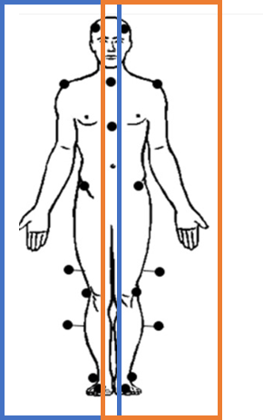
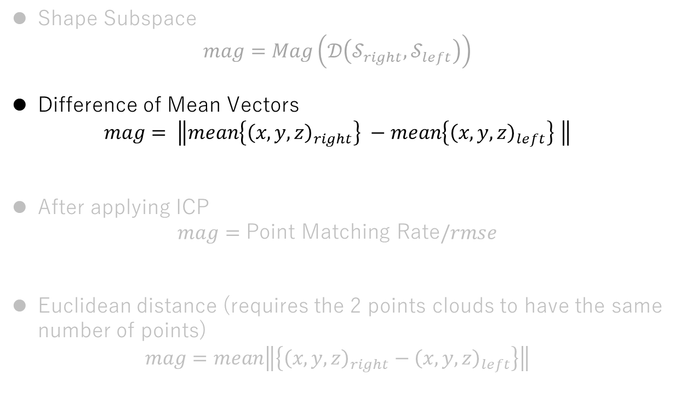
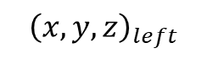
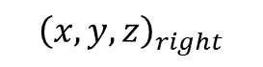
実験
Evaluation of Symmetry
Shape Subspace
$$mag=Mag\left(𝒟\left(𝒮_{right},𝒮_{left}\right)\right)$$
Difference of Mean Vectors
$$mag= \left\|mean\left\{{\left(x,y,z\right)}_{right}\right\} −mean\left\{{\left(x,y,z\right)}_{left}\right\} \right\|$$
After applying ICP
$$mag=\text{Point} \text{Matching} \text{Rate}/rmse$$
Euclidean distance (requires the 2 points clouds to have the same number of points)
$$mag=mean\left\|\left\{{\left(x,y,z\right)}_{right}−{\left(x,y,z\right)}_{left}\right\}\right\|$$
$${\left(x,y,z\right)}_{right}$$
$${\left(x,y,z\right)}_{left}$$

Slide 15
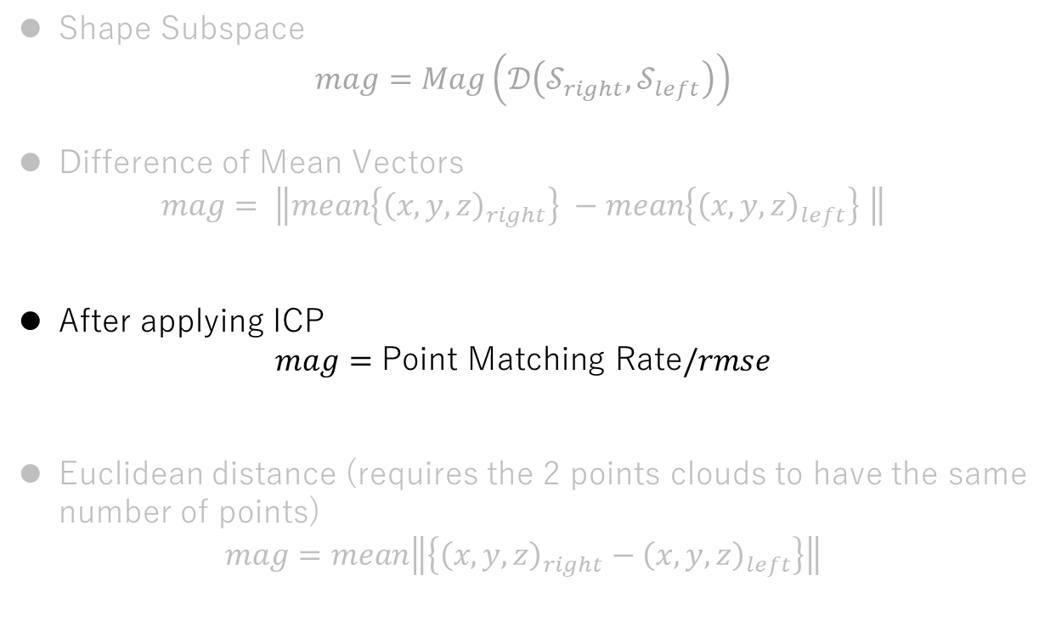
実験
Iterative Closest Point (ICP) Method for registering 2 points clouds to achieve optimal alignment
Evaluation of Symmetry
For each point in the moving point cloud, find the nearest point in the reference point cloud
Compute the rotation and translation that minimize the distances between corresponding points
Update the alignment and repeat until convergence After convergence, compute using point correspondence ratio and RMSE
Shape Subspace
$$mag=Mag\left(𝒟\left(𝒮_{right},𝒮_{left}\right)\right)$$
Difference of Mean Vectors
$$mag= \left\|mean\left\{{\left(x,y,z\right)}_{right}\right\} −mean\left\{{\left(x,y,z\right)}_{left}\right\} \right\|$$
After applying ICP
$$mag=\text{Point} \text{Matching} \text{Rate}/rmse$$
Euclidean distance (requires the 2 points clouds to have the same number of points)
$$mag=mean\left\|\left\{{\left(x,y,z\right)}_{right}−{\left(x,y,z\right)}_{left}\right\}\right\|$$

Slide 16
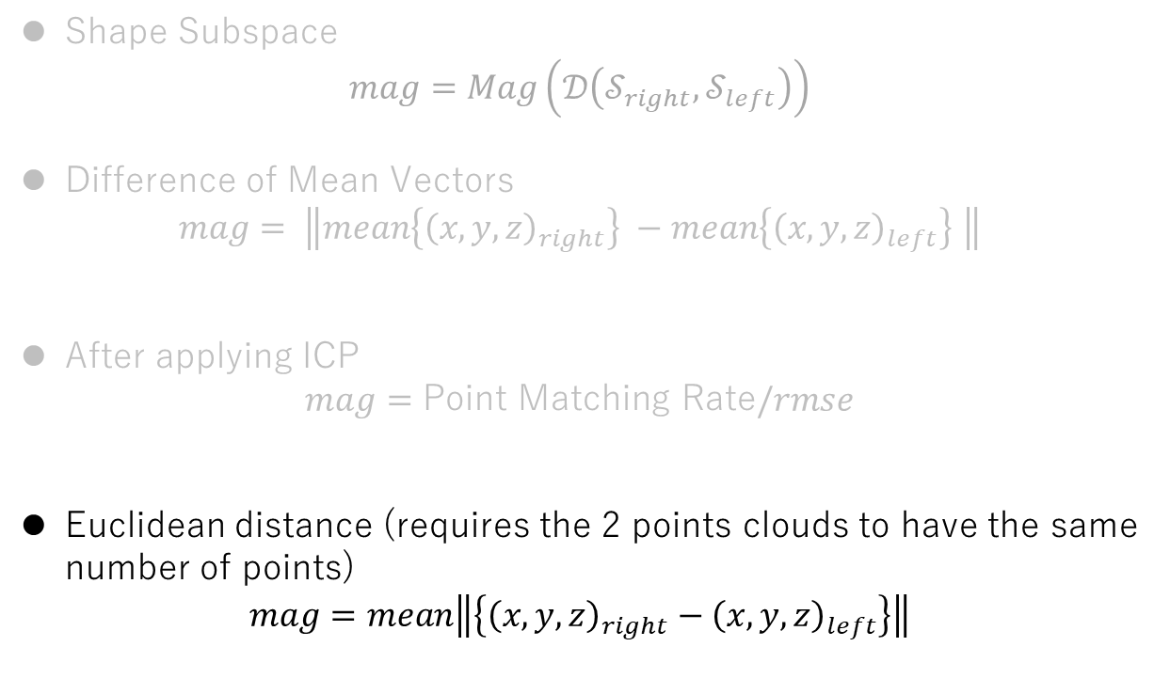
実験
Evaluation of Symmetry
Shape Subspace
$$mag=Mag\left(𝒟\left(𝒮_{right},𝒮_{left}\right)\right)$$
Difference of Mean Vectors
$$mag= \left\|mean\left\{{\left(x,y,z\right)}_{right}\right\} −mean\left\{{\left(x,y,z\right)}_{left}\right\} \right\|$$
After applying ICP
$$mag=\text{Point} \text{Matching} \text{Rate}/rmse$$
Euclidean distance (requires the 2 points clouds to have the same number of points)
$$mag=mean\left\|\left\{{\left(x,y,z\right)}_{right}−{\left(x,y,z\right)}_{left}\right\}\right\|$$
Euclidean distance

Slide 17
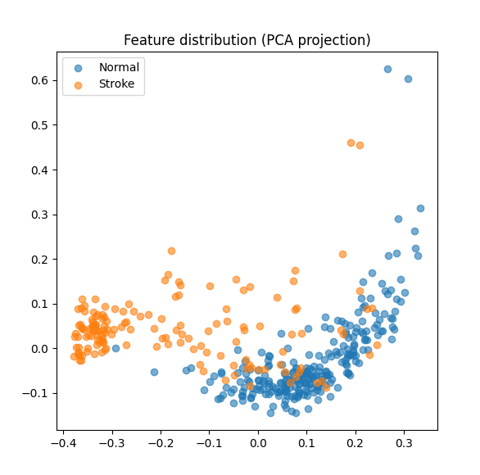
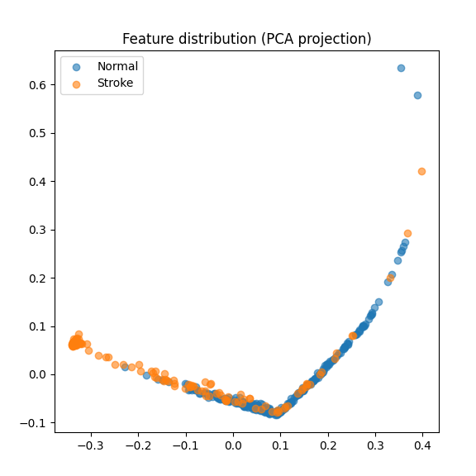
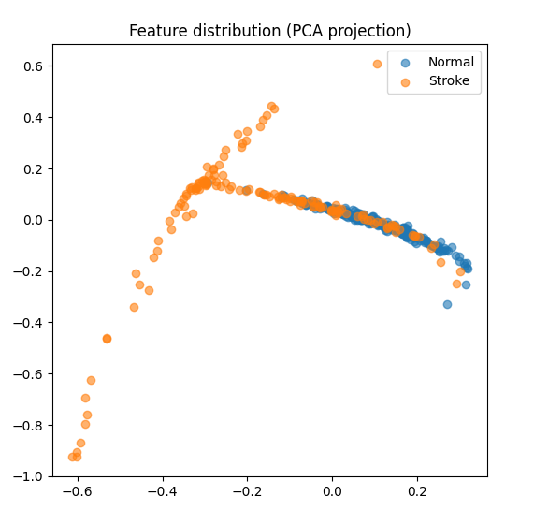
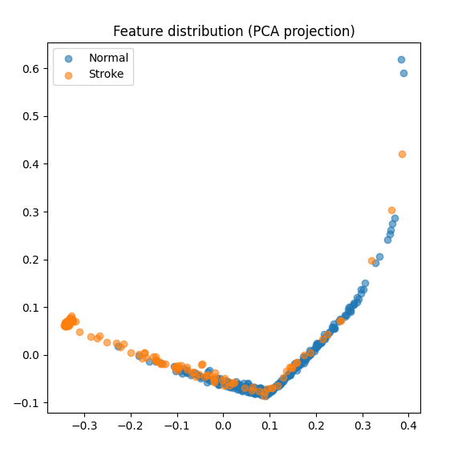
実験
method | discriminant ratio
Shape Subspace | 1.7002
Difference of Mean Vectors | 2.2983
ICP | 1.1033
Euclidean distance | 2.3063
Evaluation of Symmetry
Distribution and separability (Fisher’s discriminant ratio) of FFT features
Shape Subspace
Difference of Mean Vectors
ICP
Euclidean distance

Slide 18
実験
Evaluation of Symmetry
Dimension of FFT features: 150 (half of 300 points covering 0 to 50 Hz)
Training normal features 203
Validation normal features 50
Stroke All features 152
method | AUC(Dimension of the normal subspace: 5) | AUC(Dimension of the normal subspace: 3) | AUC(Dimension of the normal subspace: 2)
Shape Subspace | 0.9099 | 0.9169 | 0.9267
Difference of Mean Vectors | 0.5611 | 0.8167 | 0.8338
ICP | 0.7153 | 0.8258 | 0.8404
Euclidean distance | 0.6997 | 0.8591 | 0.8711

Slide 19
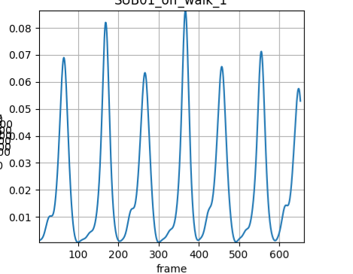
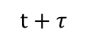
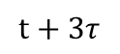
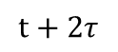
実験
Evaluation of Shape Variations
Instead of focusing on left-right shape differences, the evaluation focuses on overall temporal shape variations
time
$$t+τ$$
$$t+2τ$$
$$t+3τ$$
…
…
…
FFT features were computed for these variations, and metrics such as AUC were calculated in the same manner

Slide 20
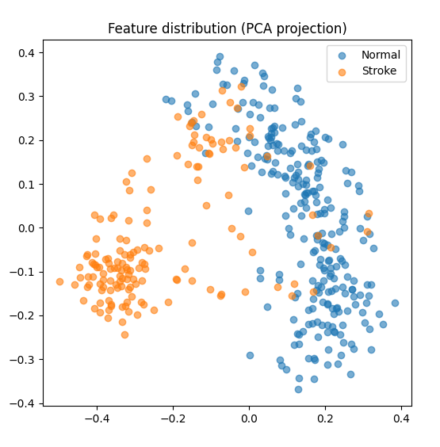
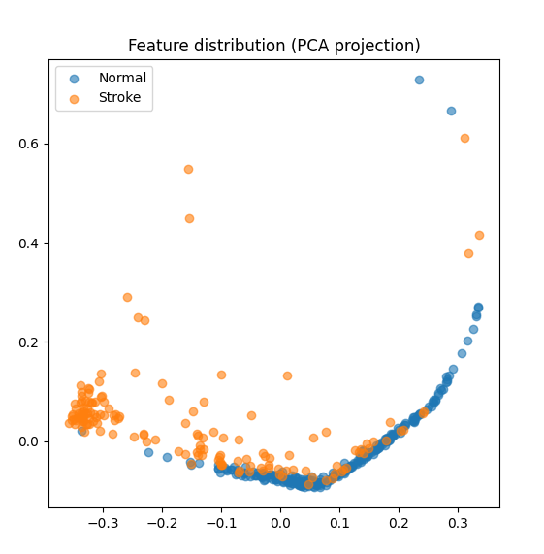
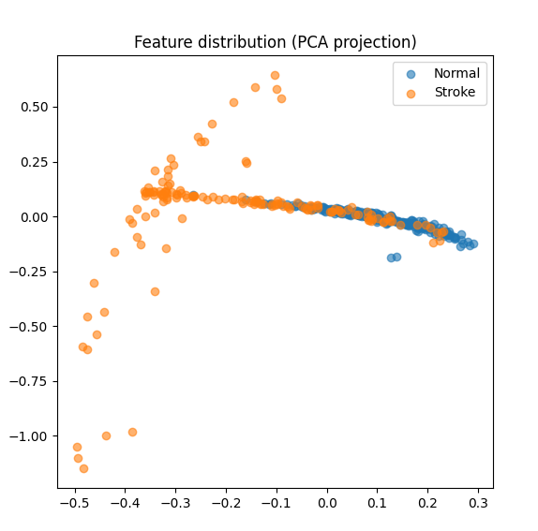
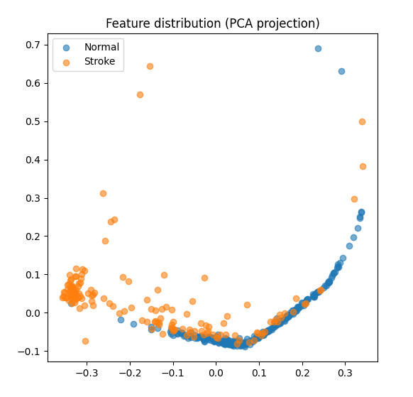
実験
Evaluation of Shape Variations
method | 分離度
Shape Subspace | 1.0664
Difference of Mean Vectors | 1.5358
ICP | 0.9511
Euclidean distance | 1.4978
Distribution and separability (Fisher’s discriminant ratio) of FFT features
Shape Subspace
Difference of Mean Vectors
ICP
Euclidean distance

Slide 21
実験
Evaluation of Shape Variations
Frame interval: 5
Dimension of FFT features: 150 (half of 300 points covering 0 to 50 Hz)
Training normal features 203
Validation normal features 50
Stroke All features 152
method | AUC(Dimension of the normal subspace: 5) | AUC(Dimension of the normal subspace: 3) | AUC(Dimension of the normal subspace: 2)
Shape Subspace | 0.8968 | 0.9164 | 0.8949
Difference of Mean Vectors | 0.9096 | 0.8863 | 0.9136
ICP | 0.9036 | 0.9083 | 0.9092
Euclidean distance | 0.9106 | 0.8866 | 0.9130

Slide 22
Feature Work / まとめ
Gait evaluation considering both segmental coordination and temporal variations of the entire shape is possible
Although gait data from patients with disorders are limited, stable analysis can be achieved using the subspace method, which is relatively robust to the amount of data
In evaluating gait symmetry, the shape subspace method demonstrates particularly high effectiveness and may capture the geometric coordination between different body segments
Changes in results due to hyperparameters and shape variations are also examined, including second-order differences
We want to perform reliable gait evaluation

